Slide 1

MA2012 INTRODUCTION TO MECHATRONICS SYSTEMS DESIGN
Lecture 6
Prof Ang Wei Tech
College of Engineering
School of Mechanical and Aerospace Engineering

Slide 2
Mechatronic System Components
MECHANICAL SYSTEM
-system model -dynamic response
ACTUATORS
-solenoid, voice coils
-DC motors
-stepper motors
-servo motors
-hydraulics, pneumatics
SENSORS
-switches -strain gage
-potentiometer -thermocouple
-photoelectrics -accelerometer
-digital encoder -MEMs
INPUT SIGNAL
CONDITIONING
AND INTERFACING
-discrete circuits -filters
-amplifiers -A/D, D/D
OUTPUT SIGNAL
CONDITIONING
AND INTERFACING
-D/A, D/D -power transistors
-amplifiers -power op amps
-PWM
DIGITAL CONTROL
ARCHITECTURES
-logic circuits -sequencing and timing
-microcontroller -logic and arithmetic
-SBC -control algorithms
-PLC -communication
GRAPHICAL
DISPLAYS
-LEDs -LCD
-digital displays -CRT

Slide 3
Signal Conditioning
INPUT SIGNAL CONDITIONING
To convert the output of sensing elements into a form suitable for further processing
Types
Analog-to-Digital conversion
To reduce noise level
To enhance signal power
To improve noise immunisation
To eliminate non-linearity
OUTPUT SIGNAL CONDITIONING
To convert the output of digital control systems (i.e. MCU, PC) into a form suitable for interfacing with output elements
Types
Digital-to-Analog conversion
To amplify signal (power, current, voltage, etc.)
To improve noise immunisation

Slide 4
Deterministic vs Random Signals
Deterministic Signals
Value can be predicted exactly, after the observation period T₀
Random Signals
Value cannot be predicted exactly, after the observation period T₀
The signal cannot be represented by a continuous algebraic equation y(t) for the signal y at time t
Deterministic vs Random Signals

Slide 5

Randomness
A real process has many parameters that cannot be exactly known, because of the randomness of nature
Absolutely clean signal does not exist, if resolution is allowed to be infinitesimally small, i.e. Observed randomness is dependent on resolution
E.g. Leaves falling from a tree
Randomness: leaves falling from a tree

Slide 6
















Randomness
E.g. Leaves falling from a tree:
Resolution = 1 m² → noisy outcome
Resolution = 100 m² → clean outcome

Slide 7
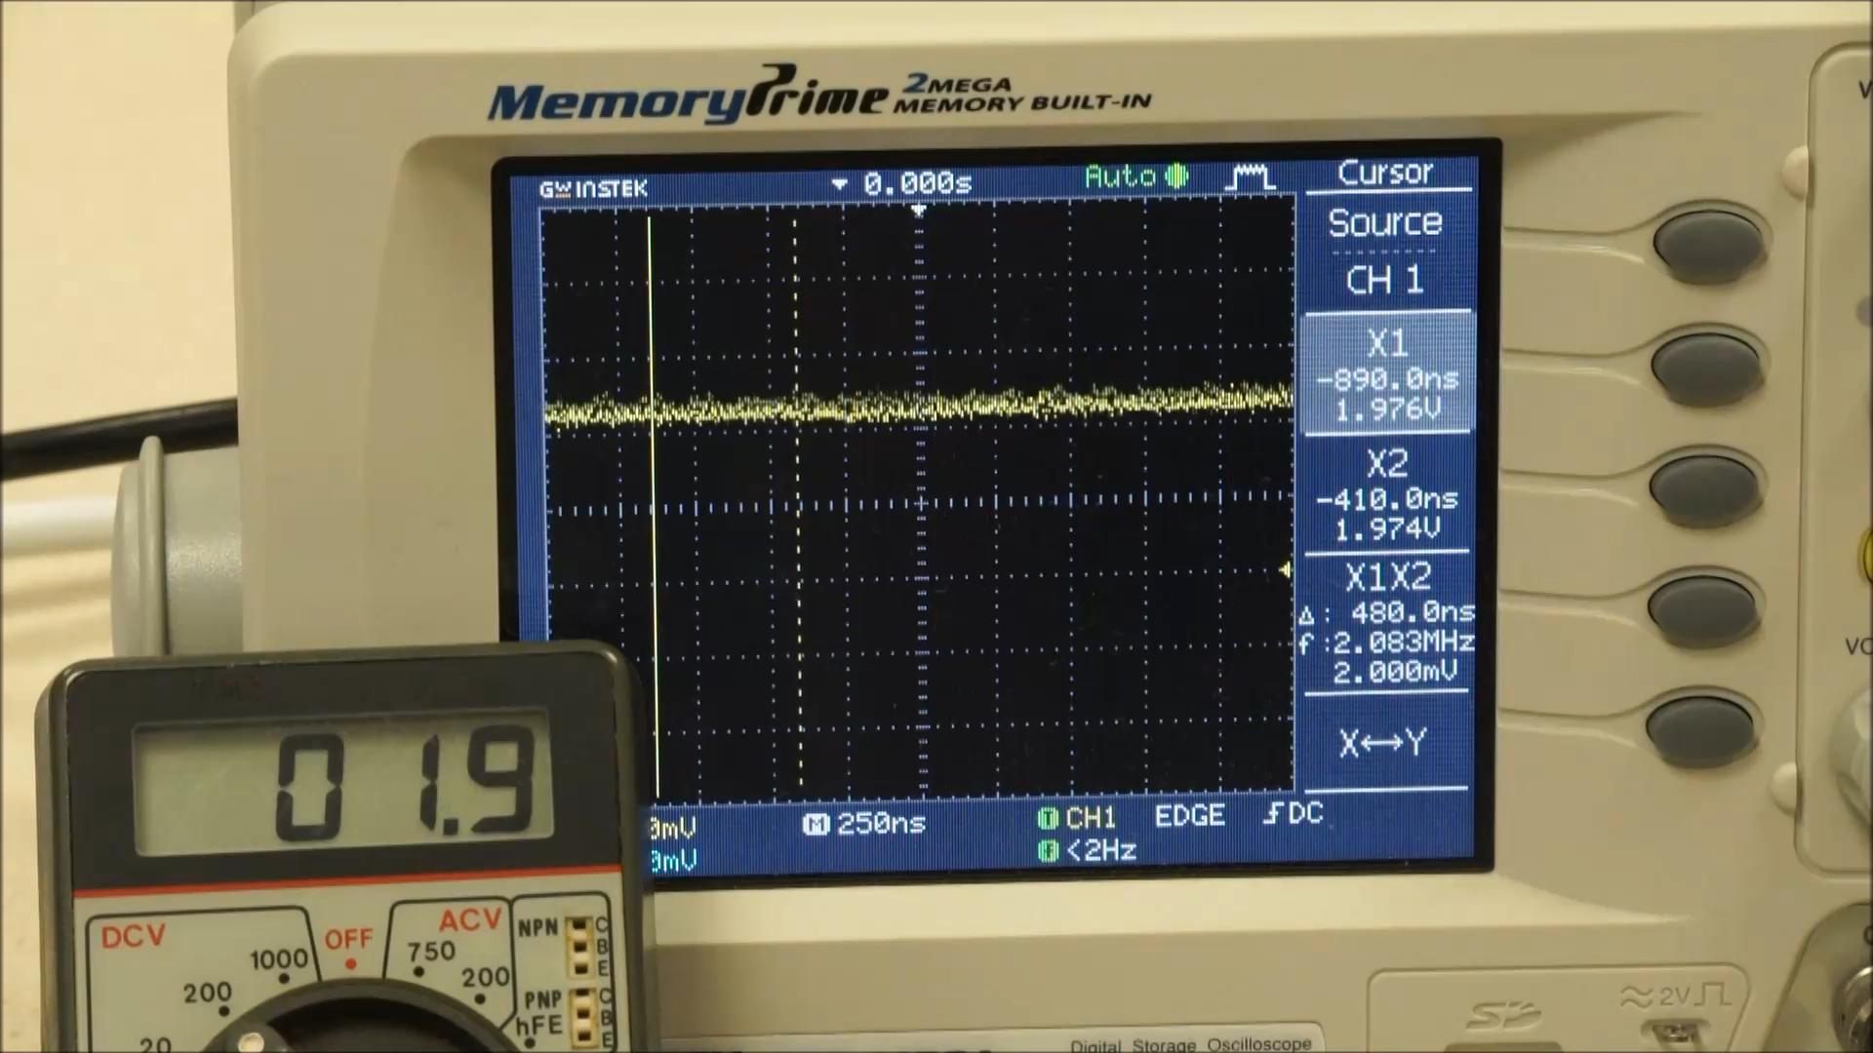
Randomness
Click image to play video
Voltage source
E.g. A voltage source:
Resolution = 0.1 V → clean voltage
Resolution = 0.001 V → noisy voltage

Slide 8
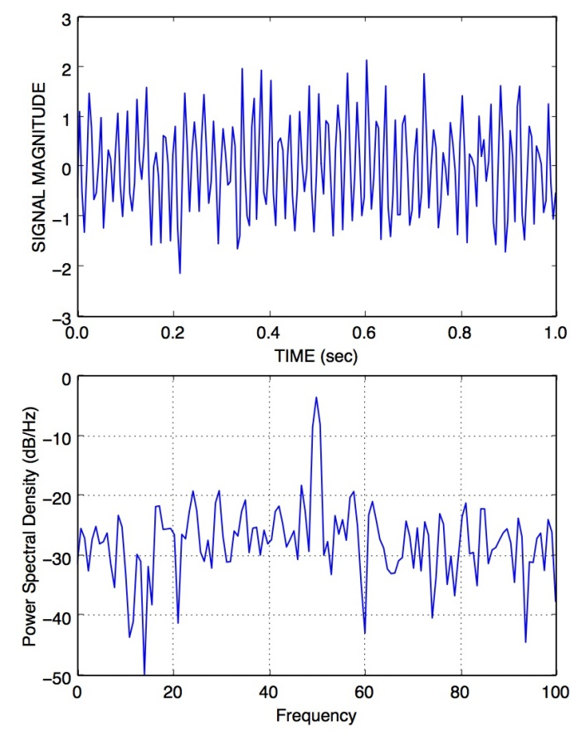
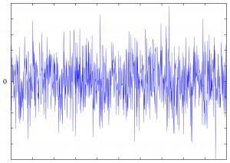
Noise
Noise is unwanted signal
White noise = signal with equal power in all frequencies and zero mean, i.e. totally random signal
Coloured noise = unwanted signal with certain bias or distinctive frequency(ies)
Dominant 50 Hz signal
White noise
Coloured noise

Slide 9
















Noise
Side view
Wind
top view
Wind
Coloured Noise e.g. Falling leaves with wind blowing
Mean of the leaves spread is no longer at the foot of the tree, i.e. non-zero mean or bias

Slide 10
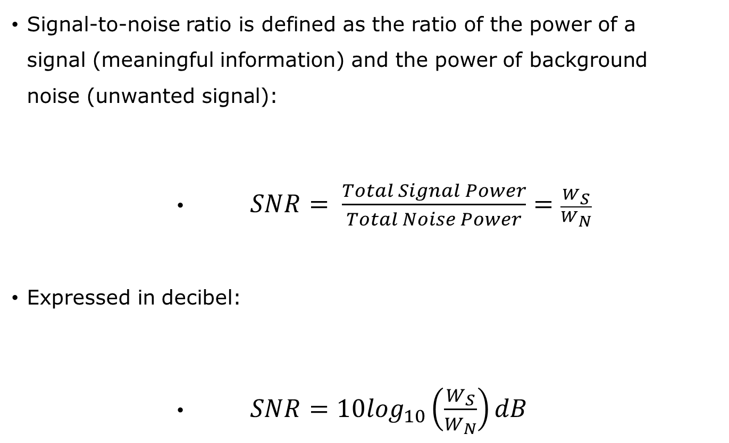
Signal-to-Noise Ratio
Signal-to-noise ratio is defined as the ratio of the power of a signal (meaningful information) and the power of background noise (unwanted signal):
$SNR= \frac{Total Signal Power}{Total Noise Power}=\frac{W_{S}}{W_{N}}$
Expressed in decibel:
$SNR=10\log_{10}\left(\frac{W_{S}}{W_{N}}\right)dB$

Slide 11
Noise Sources
INTERNAL NOISE SOURCES
Johnson or thermal noise
Random, temperature-induced motion of electrons and other charge carriers in resistors and semiconductors gives rise to a corresponding random voltage
White noise proportional to the absolute temperature
Shot noise
Random fluctuations in the rate at which carriers diffuse across a junction of transistor
Another source of white noise

Slide 12
Noise Sources
EXTERNAL NOISE AND INTERFERENCE SOURCES
AC power circuits operating at 220V, 50Hz (US:110V, 60Hz)
Produce “mains pick-up” or “hum” which is a corresponding sinusoidal interference signal in the measurement circuit
Fluorescent lighting arcing at 2x per cycle of the AC power
Arcing is the process of raising the potential to cause electrical current to flow between anode & cathode through the inert gases inside the tube
Radio frequency (RF) interference
Transmitters, welding equipment and electric arc furnaces can produce interference at frequencies of several MHz

Slide 13
Input Signal Conditioning Elements
Suitable forms
DC voltage [MA 2012]
DC current; Variable frequency AC voltage
Examples:
Deflection bridges
Operational amplifiers (Op-Amp)
Filters
Input
Sensing
element
Signal
Conditioning
element
Signal
processing
element
Data
presentation
element
Output
True
value
Measured
value
Input signal conditioning elements

Slide 14
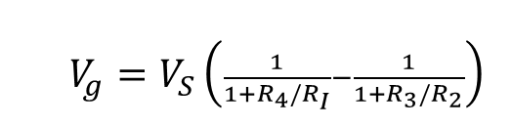
Deflection Bridges
Quarter Bridge
Voltage output:
Half Bridge
Double sensitivity over ¼B
${V_{g}=V}_{S}\left(\frac{1}{1+R_{4}/R_{I}}−\frac{1}{1+R_{3}/R_{2}}\right)$
R₁ (+ε)
V_{g}
R₂ (-ε)
Half bridge
Full Bridge
Simplicity & linearity over ½B
Quarter bridge
Full bridge

Slide 15
Amplifiers
The operational amplifiers (op-amps) are used as the basic building blocks for instrumentation and power amplifiers
Types of op-amp
Inverting
Non-inverting
Voltage follower
Voltage adder
Differential

Slide 16
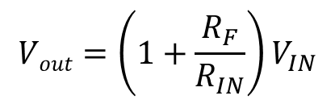
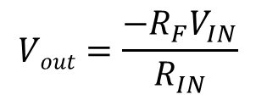
Op-Amp
Inverting amplifier
Non-inverting amplifier
$$Vout=\frac{−R_{F}V_{IN}}{R_{IN}}$$
Inverting amplifier
$$Vout=\left(1+\frac{R_{F}}{R_{IN}}\right)V_{IN}$$
Non-inverting amplifier

Slide 17
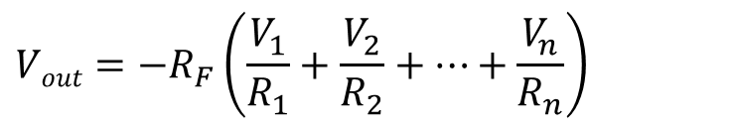
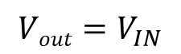
Op-Amp
Voltage follower
Voltage adder
$$Vout=−R_{F}\left(\frac{V_{1}}{R_{1}}+\frac{V_{2}}{R_{2}}+…+\frac{V_{n}}{R_{n}}\right)$$
$$Vout=V_{IN}$$
Voltage follower
Voltage adder

Slide 18
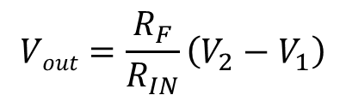
Op-Amp
Differential amplifier
Common mode interference voltages can be successfully rejected
$$Vout=\frac{R_{F}}{R_{IN}}\left(V_{2}−V_{1}\right)$$
Differential amplifier

Slide 19
Filtering
A frequency selective filter is an element which transmits a certain selected range(s) of frequencies and rejects all others
Analog filter is a network of resistors, capacitors and op amps to process continuous signals
Digital filter is a computer programmed to process sampled values of a signal
Filtering

Slide 20
Filtering
Low & High Pass Filters
Low and high pass filters

Slide 21


Filtering
River Stream

Slide 22



Filtering
River dries up
Dry Season, Drought

Slide 23

Filtering
Rainy Season/Accelerated Snow melt

Slide 24


Filtering
Flooding occurs
Rainy Season/Accelerated Snow melt

Slide 25



Filtering
WITH A DAM
Flood Control Dam
Reservoir
River Stream

Slide 26



Filtering
WITH A DAM
Water from reservoir released into river
Water from reservoir flowing through the dam into the river
Dry river bank
Dry Season, Drought

Slide 27



Filtering
WITH A DAM
Water level go up

Slide 28


Filtering
WITH A DAM
Rainy Season/Accelerated Snow melt

Slide 29


Filtering
WITH A DAM
Excess water collected in reservoir

Slide 30
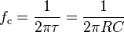
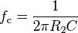
RC Filters
Low Pass Filters
Passive
Active
Passive low pass filter
Active low pass filter

Slide 31
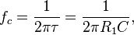
RC Filters
High Pass Filters
Passive
Active
Passive high pass filter
Active high pass filter

Slide 32
Filtering
Band Pass & Band Stop Filters
Band pass and band stop filters

Slide 33
Reducing Effects of Noise & Interference
Averaging
Reducing effects of noise and interference - averaging

Slide 34
Reducing Effects of Noise & Interference
Averaging
For a repetitive measurement signal affected by random noise, suppose
It has a period T, a total of p cycles & N samples in each cycle, giving pN samples in total
For each sample, there are p number of corresponding samples from each cycle
The average value of the i^{th} sample is

Slide 35
Reducing Effects of Noise & Interference
Averaging
Reducing effects of noise and interference - averaging

Slide 36
Output Signal Conditioning Elements
Purpose
To convert the output of MCU into a form suitable for interfacing with the output devices
Suitable forms
Analog signal: voltage or current
Higher voltage
Higher current
Alternating current
Output signal conditioning elements

Slide 37
Digital-to-Analog Converter
Simplest type of DAC is a resistor ladder network connected to an inverting op amp circuit
Resistor ladder network connected to an inverting op amp circuit

Slide 38
Digital-to-Analog Converter
Consider a 4-bit output 0001
Analog circuit equivalent:
4-bit output: analog circuit equivalent

Slide 39
Digital-to-Analog Converter
Using voltage division,
V₀ = 0.5V₁; V₁ = 0.5V₂ and V₂ = 0.5V₃
Therefore, V₀ = 0.125V₃ = 0.125V_{s}
V₀ is the input to the inverting op amp, which has a gain of -R/2R = -0.5
Therefore, the analog output voltage of input 0001 is V_{out0} = -0.0625V_{s}
4-bit output: analog circuit equivalent

Slide 40
Digital-to-Analog Converter
Analog output voltage of input
0010 is Vout₁ ⁼ - 0.125 Vs
0100 is Vout₂ ⁼ - 0.25 Vs
1000 is Vout₃ ⁼ - 0.5 Vs
The output for any combination of the four bits is
Vout = b₃Vout₃ + b₂Vout₂ + b₁Vout₁ + b₀Vout₀
4-bit output: analog circuit equivalent

Slide 41
Summary
Signals & Noise
Deterministic vs random signals
Noise characteristics & sources
Signal-to-Noise Ratio
Input Signal Conditioning
Deflection Bridge: Quarter, Half, Full
Op-amps: Inverting, non-inverting, differential, voltage follower, voltage adder
Filters: Low Pass, High Pass, Band Pass, Band Stop
Averaging
Output Signal Conditioning
Digital-to-Analog Converter

